Slide 1

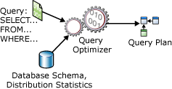
CMPT 506
Query Processing and Optimization
Read ch 6, 18 and 19

Slide 2
Outline
Query Processing Overview
Relational Algebra Review
Logical Query Plans
Query Rewrite Rules
Physical Query Plan
Implementing Selection σ_{(attr op value)}
Sort-Merge Algorithm
Join Operator Implementation

Slide 3
Query Processing Overview
Notes:
Relational algebra is a branch of Math that deals with sets
http://en.wikipedia.org/wiki/Relational_algebra#Selection_.28.CF.83.29

Slide 4
Why Study Query Processing and Optimization?
Become familiar with the internals of the Query Optimizer and the execution plans it produces
Need to know Query Operator algorithms to understand query plans
Need to understand query plans to tune a DBMS
Take your query writing and performance diagnostic skills to the next level
=> Better placed to write queries that optimize well, and to debug plan-related performance problems
Notes:
Take your query writing and performance diagnostic skills to the next level by becoming familiar with the internals of the SQL Server query optimizer and the execution plans it produces. This session covers deep optimizer internals and little-known query processor details that will give you new insights into the way SQL Server works behind the scenes. Armed with this information, you will be better placed to write queries that optimize well, and to debug plan-related performance problems when they occur.
• Good algorithms can greatly improve performance
– Need to know operator algorithms to understand query plans
– Need to understand query plans to tune a DBMS

Slide 5

Query Processing
Query Processing: Translate high level queries (e.g. SQL query) to low level operations (or algorithms) on the data files to retrieve the required data
SQL is a declarative language. It provides a way for the query writer to logically describe the results required
The Query Optimizer (QO) compiles and optimizes the SQL query to create an efficient physical plan that the Query Processor (QP) can execute
High-level
Query Q
Answer
- Translates Q into
best execution plan
for current conditions
- Runs plan
DBMS
Data
Notes:
When we write a query, we are not writing a computer program that can be directly executed. SQL is a declarative language used to logically describe the results we want to see. SQL Server goes through a process of compilation and optimization to create a physically executable implementation of the stated logical requirement. To put it another way, a SQL query is the specification for an executable program that SQL Server writes for us. The SQL Server component responsible for finding an efficient physical execution plan for a given logical query requirement is the Query Optimizer.
Activities involved in retrieving data from the database.
QO transforms a query written in high-level language (e.g. SQL), into correct and efficient execution plan.
QP executes the plan to retrieve required data.
expressed in low-level language (implementing Relational Algebra)
Generating equivalent logical plans and their physical plans is known as query optimization
Selecting a good query plan entails deciding
Which equivalent plan leads to the most efficient query
Which algorithm should be used to implement an operation
How data from one operation should be passed to the next
These choices depend on database metadata
Size of relations
Number and frequency of attributes
Indexing and data file organization

Slide 6
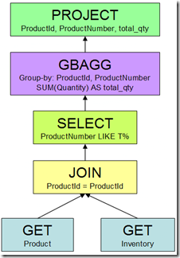
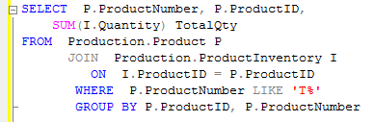
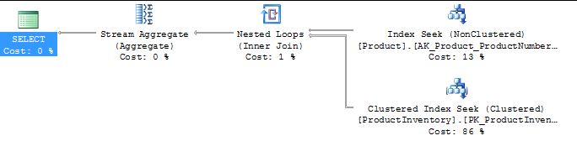
Query Processing Example
Transformed Into a Logical Plan (tree of logical relational operators)
Translate this into a physical plan that can be executed by the Query Processor
Notes:
https://www.simple-talk.com/sql/performance/graphical-execution-plans-for-simple-sql-queries/
Best Resource: http://sqlblog.com/blogs/paul_white/archive/2012/04/28/query-optimizer-deep-dive-part-1.aspx
Query Plan:
logical tree
implementation choice at every node
scheduling of operations.
http://sqlblog.com/blogs/paul_white/archive/2010/07/29/inside-the-optimiser-constructing-a-plan.aspx
Nested Loops (other implementation rules exist for Merge and Hash join).
Query rewrite based on mathematical equivalences or heuristics.
A simple example of an exploration rule is 'Join Commute'. This rule exploits the fact that A JOIN B is the same as B JOIN A (for inner joins).
The optimizer also has simplification rules and enforcer rules. Application of all these rules generates alternative strategies.
The Cartesian product has been replaced by a more normal-looking Nested Loops operator, which is a result of the join predicate being moved from the Filter into the join. In fact, the Filter operator has disappeared completely - where has the predicate “ProductNumber LIKE 'T%'” gone? It has also been pushed down the plan - all the way to the Product table scan.
More examples:
http://sqlblog.com/blogs/paul_white/archive/2010/07/28/the-segment-top-query-optimisation.aspx
Run the example:
SELECT P.ProductNumber, P.ProductID,
SUM(I.Quantity) TotalQty
FROM Production.Product P
JOIN Production.ProductInventory I
ON I.ProductID = P.ProductID
WHERE P.ProductNumber LIKE 'T%'
GROUP BY P.ProductID, P.ProductNumber
Show query re-write + disable the indexes and show that the Query Optimizer selects a different Execution Plan.

Slide 7
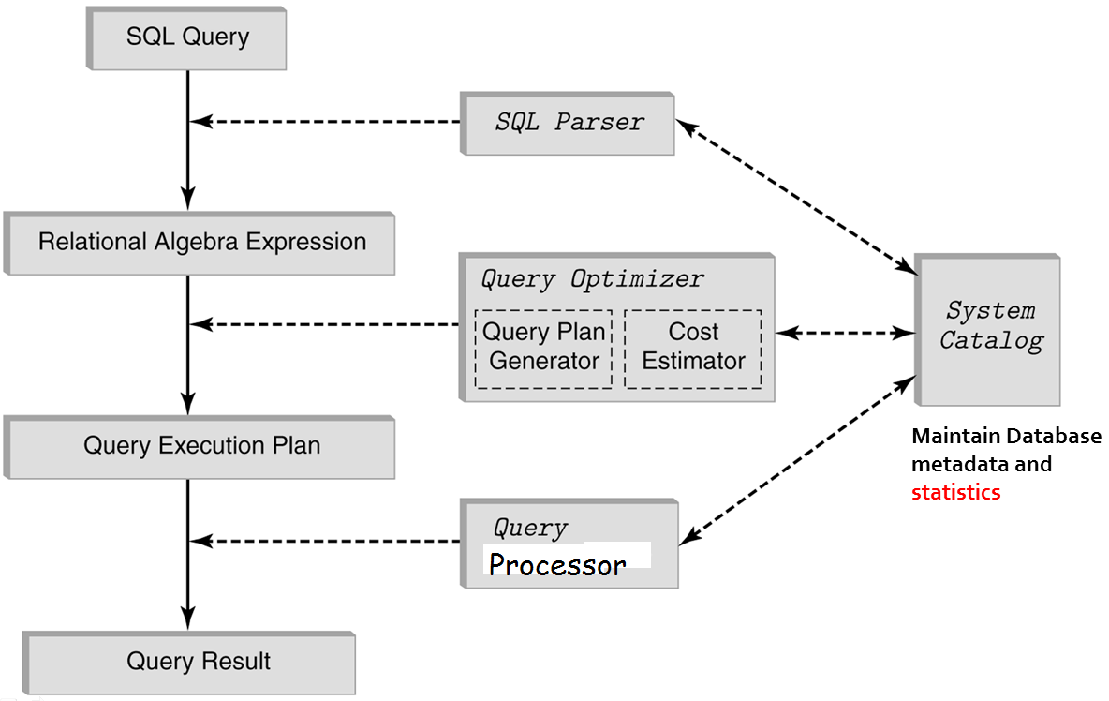
Query Processing Architecture
Notes:
Query processing includes translation of high-level queries into low-level expressions that can be used at the physical level of the file system, query optimization and actual execution of the query to get the result. It is a three-step process that consists of parsing and translation, optimization and execution of the query submitted by the user.
1. Parsing and translation: Whenever a user submits a query in high-level language (such as SQL) for execution, it is first translated into its internal representation suitable to the system. The internal representation of the query is based on the extended relational algebra. Thus, an SQL query is first translated into an equivalent extended relational algebra expression. During translation, the parser checks the syntax of the user's query according to the rules of the query language. It also verifies that all the attributes and relation names specified in the query are the valid names in the schema of the database being queried.
2. Optimization: Generally, there are several possible ways of executing a query (known as execution strategies), and different execution strategies can have different costs. It is the responsibility of the query optimizer, a component of DBMS, to choose a least costly execution strategy. This process of choosing a suitable execution strategy for processing a query is knows as query optimization. The metadata stored in the special tables called DBMS catalog is used to find the best way of evaluating a query.
3. Execution: The chosen execution strategy is finally submitted to the query-evaluation engine for actual execution of the query to get the desired result.
Query optimizer cannot look at all plans (might take longer to find an optimal plan than to compute query brute-force). Hence it does not necessarily produce optimal plan
generating, improving and estimating cost of query plans then selecting the best execution plan
algorithms to implement physical plan operators

Slide 8
DBMS Components for Query Processing
Query Parser – Verify validity of the SQL statement. Translate the query into a parse tree using Relational Algebra (RA)
Query Optimizer:
Generate equivalent logical query plans
Estimate cost of query plans
Select the cheapest plan
Generate a physical plan = select algorithms for each of the operators in the query
Query processor – Executes the physical query plan
Notes:
Along with Parsing …
Semantic checks
Do the projected attributes exist in the relations in the From clause?
Ambiguous attributes?
Type checking, ex: R.A > 17.5
Expand views
Query Plan Evaluator – Make calls for the Query processor as a result of the work done by the optimizer.
Parsing
Construct a parse tree for a query
Generate equivalent logical query plans
Convert the parse tree to a query plan in relational algebra
Transform the plan into more efficient equivalents
Generate a physical plan
Select algorithms for each of the operators in the query
Including details about how tables are to be accessed or sorted
Including details about how tables are to be accessed
The parser takes an SQL query and converts it to a parse tree
A parse tree is a tree whose nodes are
Atoms – keywords, attribute names, relations, constants, operators
Syntactic categories – families of query subparts such as a query or a condition
A node that is an atom has no children
If a node is a syntactic category it is described by one of the rules of the grammar

Slide 9
Query Plan Caching
Query Optimization improves query performance
But it is expensive (memory, CPU, time)
=> We need plan caching...
Finding an existing plan is based on:
ID of the object (for Stored Procedures, triggers, functions etc.)
Hash of the query text (for ad-hoc queries)

Slide 10
Query Execution Phases
Query
Cache lookup
Found
Not found
Compile query
Schema
Statistics
Check plan
Plan valid?
No
Yes
Execute query

Slide 11
Query Optimization
Query Optimization (QO) = choosing an execution plan with lowest total execution cost
Execution cost includes Disk I/Os and Processor time
Cost is mainly determined by the number of disk blocks read and written during the query execution - because it is the most time consuming action-
Selecting a good query plan entails deciding
Which plan leads to lowest total execution cost
Which algorithm should be used to implement each of the operators in the query
How data from one operation should be passed to the next
These choices depend on database metadata
Size of relations
Indexes and data file organization
Attributes statistics, e.g., number of distinct values, min, max values
Notes:
CPU Cost + I/O Cost
The cost of plan depends on the metric you wish to optimize
Resource usage (CPU + I/O + Network)
Cost is the sum of the resources used by each operator
Response time
Cost of the slowest path in the tree
Number of I/Os
Cost is the sum of the I/Os generated by each operator
Network cost
Cost is sum of cost in moving data between operators
Cost of execution plans includes processor time and communication time.
The most important factor to consider is disk I/Os because it is the most time consuming action.
choosing an efficient execution plan for processing a query.
reduce total execution TIME of query
Process of selecting one execution plan from many possible plans
Cost-based selection – aimed at finding execution plan with the lowest (or close to lowest) estimated execution cost
QO transforms a query written in high-level language (e.g. SQL), into correct and efficient execution plan.
QP executes the plan to retrieve required data.
Generating equivalent logical plans and their physical plans is known as query optimization
As there are many equivalent transformations of same high-level query, the aim of QO is to choose one that minimizes resource usage.

Slide 12
Cost Parameters
Cost of an operation = number of disk I/Os to
Read the operands
Compute the result
Cost Parameters:
– B(R) = # of blocks for relation R
– T(R) = # of tuples in relation R
– V(R, a) = # of distinct values of attribute a
• When a is a key, V(R,a) = T(R)
• When a is not a key, V(R,a) < T(R)
Notes:
Cost = total number of I/Os
I/O Cost used to select between query plans and Operator Algorithms
Cost of Scanning a Table =
• Result may be unsorted: B(R)
• Result needs to be sorted: 3B(R)
– We will discuss sorting later

Slide 13
Database Statistics
Here are typical statistics kept
For a relation
Number of tuples, number of tuples per block, number of blocks
For an attribute
Number of distinct values, min, max values
Selection cardinality – avg number of records satisfying an equality condition
For an index
Number of levels, number of leaf blocks

Slide 14
Updating Statistics
Success of estimation depends on amount and currency of statistical information DBMS holds
Keeping statistics current can be problematic
If statistics updated every time tuple is changed, this would impact performance
DBMS could update statistics on a periodic basis, for example nightly, or whenever the system is idle

Slide 15
Relational Algebra Review
π...(σ...(Α) − σ...(Β))
Notes:
Relational algebra is a branch of Math that deals with sets
http://en.wikipedia.org/wiki/Relational_algebra#Selection_.28.CF.83.29

Slide 16
Relational Operations
Basic Operators
Selection (σ ) Selects a subset of rows from relation
e.g., σ_{age > 60}(Employee) returns all employees over 60
Projection (π) Selects desired columns from relation
e.g., π_{id, salary}(Employee) returns all IDs, and salaries
Set Operations
Set-difference ( _ ) Tuples in R, but not in S
Union (∪ ) Tuples which are either in R, or in S, or in both
Intersection (∩) Tuples that R and S have in common
Cartesian Product (X) every tuple of R is matched with every tuple of S
Aggregation (SUM, MIN, etc.) and GROUP BY
Join ( ) Allows us to combine two relations
R ⋈ S is the natural join of the relations R and S, the set of all combinations of tuples in R and S that are equal on their common attribute names
Notes:
3
Pi
σ Sigma
R ⋈ S is the natural join of the relations R and S, the set of all combinations of tuples in R and S that are equal on their common attribute names.
Division (÷)
Selection (σ)
σ_{age > 60}(Employee) returns all employees over 60
Projection (π)
π_{id, salary}(Employee) returns all IDs, and salaries
Set Operations
Union (∪)
Intersection (∩)
Set Difference (−)
Cartesian Product (×)
Joins ( )

Slide 17
Union Compatibility
Doctor
sin | fName | lName | speciality
555 | Tom | Baker | Cardiology
123 | William | Hartnell | GP
499 | Jon | Pertwee | Oncology
674 | David | Tennant | Neurology
Doctor ∩ Patient
Not union
compatible
Patient
msp | sin | fName | lName | age
34456 | 555 | Tom | Baker | 41
77321 | 321 | Lalla | Ward | 32
11387 | 499 | Jon | Pertwee | 53
12121 | 674 | Billie | Piper | 27

Slide 18
Intersection
Doctor
sin | fName | lName | speciality
555 | Tom | Baker | Cardiology
123 | William | Hartnell | GP
499 | Jon | Pertwee | Oncology
674 | David | Tennant | Neurology
π_{sin,fName,lName}(Doctor) ∩ π_{sin,fName,lName}(Patient)
sin | fName | lName
555 | Tom | Baker
499 | Jon | Pertwee
Patient
msp | sin | fName | lName | age
34456 | 555 | Tom | Baker | 41
77321 | 321 | Lalla | Ward | 32
11387 | 499 | Jon | Pertwee | 53
12121 | 674 | Billie | Piper | 27
R ∩ S : elements that R and S have in common

Slide 19
Union
Doctor
sin | fName | lName | speciality
555 | Tom | Baker | Cardiology
123 | William | Hartnell | GP
499 | Jon | Pertwee | Oncology
674 | David | Tennant | Neurology
π_{sin,fName,lName}(Doctor) ∪ π_{sin,fName,lName}(Patient)
sin | fName | lName
555 | Tom | Baker
123 | William | Hartnell
499 | Jon | Pertwee
674 | David | Tennant
321 | Lalla | Ward
674 | Billie | Piper
Patient
msp | sin | fName | lName | age
34456 | 555 | Tom | Baker | 41
77321 | 321 | Lalla | Ward | 32
11387 | 499 | Jon | Pertwee | 53
12121 | 674 | Billie | Piper | 27
R ∪ S : elements which are either in R, or in S, or in both.

Slide 20
Set Difference
Doctor
sin | fName | lName | speciality
555 | Tom | Baker | Cardiology
123 | William | Hartnell | GP
499 | Jon | Pertwee | Oncology
674 | David | Tennant | Neurology
π_{sin,fName,lName}(Doctor) − π_{sin,fName,lName}(Patient)
sin | fName | lName
123 | William | Hartnell
674 | David | Tennant
Patient
msp | sin | fName | lName | age
34456 | 555 | Tom | Baker | 41
77321 | 321 | Lalla | Ward | 32
11387 | 499 | Jon | Pertwee | 53
12121 | 674 | Billie | Piper | 27
R − S : all the elements of R that are not in S.

Slide 21
Cartesian Product
Doctor × Patient
Doctor
sin | fName | lName | speciality
555 | Tom | Baker | Cardiology
123 | William | Hartnell | GP
499 | Jon | Pertwee | Oncology
674 | David | Tennant | Neurology
(1) | (2) | (3) | speciality | msp | (6) | (7) | (8) | age
555 | Tom | Baker | Cardiology | 34456 | 555 | Tom | Baker | 41
555 | Tom | Baker | Cardiology | 77321 | 321 | Lalla | Ward | 32
555 | Tom | Baker | Cardiology | 11387 | 499 | Jon | Pertwee | 53
555 | Tom | Baker | Cardiology | 12121 | 674 | Billie | Piper | 27
123 | William | Hartnell | GP | 34456 | 555 | Tom | Baker | 41
123 | William | Hartnell | GP | 77321 | 321 | Lalla | Ward | 32
123 | William | Hartnell | GP | 11387 | 499 | Jon | Pertwee | 53
123 | William | Hartnell | GP | 12121 | 674 | Billie | Piper | 27
499 | Jon | Pertwee | Oncology | 34456 | 555 | Tom | Baker | 41
499 | Jon | Pertwee | Oncology | 77321 | 321 | Lalla | Ward | 32
499 | Jon | Pertwee | Oncology | 11387 | 499 | Jon | Pertwee | 53
499 | Jon | Pertwee | Oncology | 12121 | 674 | Billie | Piper | 27
674 | David | Tennant | Neurology | 34456 | 555 | Tom | Baker | 41
674 | David | Tennant | Neurology | 77321 | 321 | Lalla | Ward | 32
674 | David | Tennant | Neurology | 11387 | 499 | Jon | Pertwee | 53
674 | David | Tennant | Neurology | 12121 | 674 | Billie | Piper | 27
Patient
msp | sin | fName | lName | age
34456 | 555 | Tom | Baker | 41
77321 | 321 | Lalla | Ward | 32
11387 | 499 | Jon | Pertwee | 53
12121 | 674 | Billie | Piper | 27
R X S : every tuple of R is matched with every tuple of S.
Notes:
The cartesian product of two relations is a join that is not restricted by any criteria, resulting in every tuple of the first relation being matched with every tuple of the second relation. The cartesian product is implemented in SQL as the CROSS JOIN join operator.

Slide 22
Intermediate Relations
π_{fName,lName,description}(σPatient.msp = Operation.msp ∧ age > 50(Patient × Operation))
(1) | sin | fName | lName | age | opID | description | date | (9)
34456 | 555 | Tom | Baker | 41 | 12 | appendectomy | 01-01-05 | 34456
34456 | 555 | Tom | Baker | 41 | 13 | vasectomy | 02-01-05 | 11387
34456 | 555 | Tom | Baker | 41 | 14 | appendectomy | 03-01-05 | 34456
34456 | 555 | Tom | Baker | 41 | 15 | kidney transplant | 05-01-05 | 34456
77321 | 321 | Lalla | Ward | 32 | 12 | appendectomy | 01-01-05 | 34456
77321 | 321 | Lalla | Ward | 32 | 13 | vasectomy | 02-01-05 | 11387
77321 | 321 | Lalla | Ward | 32 | 14 | appendectomy | 03-01-05 | 34456
77321 | 321 | Lalla | Ward | 32 | 15 | kidney transplant | 05-01-05 | 34456
11387 | 499 | Jon | Pertwee | 53 | 12 | appendectomy | 01-01-05 | 34456
11387 | 499 | Jon | Pertwee | 53 | 13 | vasectomy | 02-01-05 | 11387
11387 | 499 | Jon | Pertwee | 53 | 14 | appendectomy | 03-01-05 | 34456
11387 | 499 | Jon | Pertwee | 53 | 15 | kidney transplant | 05-01-05 | 34456
12121 | 674 | Billie | Piper | 27 | 12 | appendectomy | 01-01-05 | 34456
12121 | 674 | Billie | Piper | 27 | 13 | vasectomy | 02-01-05 | 11387
12121 | 674 | Billie | Piper | 27 | 14 | appendectomy | 03-01-05 | 34456
12121 | 674 | Billie | Piper | 27 | 15 | kidney transplant | 05-01-05 | 34456
Patient
msp | sin | fName | lName | age
34456 | 555 | Tom | Baker | 41
77321 | 321 | Lalla | Ward | 32
11387 | 499 | Jon | Pertwee | 53
12121 | 674 | Billie | Piper | 27
Operation
opID | description | date | msp
12 | appendectomy | 01-01-05 | 34456
13 | vasectomy | 02-01-05 | 11387
14 | appendectomy | 03-01-05 | 34456
15 | kidney transplant | 05-01-05 | 34456
fName | lName | description
Jon | Pertwee | vasectomy
Notes:
T(R) * T(S) = 16

Slide 23
Intermediate Relations
π_{fName,lName,description}(σ_{Patient.msp = Operation.msp}(σ_{age > 50}(Patient) × Operation))
Patient
msp | sin | fName | lName | age
34456 | 555 | Tom | Baker | 41
77321 | 321 | Lalla | Ward | 32
11387 | 499 | Jon | Pertwee | 53
12121 | 674 | Billie | Piper | 27
msp | sin | fName | lName | age
11387 | 499 | Jon | Pertwee | 53
(1) | sin | fName | lName | age | opID | description | date | (9)
11387 | 499 | Jon | Pertwee | 53 | 12 | appendectomy | 01-01-05 | 34456
11387 | 499 | Jon | Pertwee | 53 | 13 | vasectomy | 02-01-05 | 11387
11387 | 499 | Jon | Pertwee | 53 | 14 | appendectomy | 03-01-05 | 34456
11387 | 499 | Jon | Pertwee | 53 | 15 | kidney transplant | 05-01-05 | 34456
Operation
opID | description | date | msp
12 | appendectomy | 01-01-05 | 34456
13 | vasectomy | 02-01-05 | 11387
14 | appendectomy | 03-01-05 | 34456
15 | kidney transplant | 05-01-05 | 34456
(1) | sin | fName | lName | age | opID | description | date | (9)
11387 | 499 | Jon | Pertwee | 53 | 13 | vasectomy | 02-01-05 | 11387
fName | lName | description
Jon | Pertwee | vasectomy

Slide 24
Logical Query Plans

Slide 25
Overview of
Query
Processing
SQL query
parse
parse tree
Query rewriting
Query
Optimization
statistics
logical query plan
Physical plan generation
physical query plan
execute
Query
Execution
result

Slide 26
SQL query
Initial logical plan
parse
parse tree
Rewrite rules
Query rewriting
Logical plan
statistics
logical query plan
Physical plan generation
“Best” logical plan
physical query plan
execute
result
Notes:
Optimization - Is Based on Algebraic Equivalences

Slide 27

Different Query Execution Strategies
Find all Managers that work at a Doha branch:
SELECT *
FROM staff s, branch b
WHERE s.bno = b.bno AND (s.position = ‘Manager’
AND b.city = ‘Doha’);
3 equivalent RA queries are:
σ(position='Manager') ∧ (city='Doha') ∧ (staff.bno=branch.bno) (Staff X Branch)
σ(position='Manager') ∧ (city='Doha') (Staff Branch)
(σ_{position='Manager'}(Staff)) (σ_{city='Doha'} (Branch))
Cartesian Product
Join

Slide 28
Assume:
1000 tuples in Staff; 50 tuples in Branch;
50 Managers; 5 Doha branches;
No indexes or sort keys;
Results of any intermediate operations stored on disk;
Tuples are accessed one at a time
Notes:
Cost of the final write is ignored;

Slide 29
Cost are:
Number of Disk Reads/Writes
(1) (1000 + 50) + 2*(1000 * 50) = 101 050
(2) (1000 + 50) + 2*1000 = 3 050
(3) (1000 + 50) + 2* (50 + 5) = 1 160
- Cartesian product and join operations are much more expensive than selection
- (3) significantly reduces size of relations being joined together

Slide 30
Example 1 - SQL To Algebraic Expression Tree
SELECT ownerAcc, amount
FROM Transaction, Account
WHERE balance = 1000000 AND ownerAcc = accID
π_{ownerAcc, amount}
Expression Tree = Query Tree = Data-flow graph of relational algebra operators
σbalance = 1000000 AND ownerAcc = accID
×
Transaction
Account
Notes:
The relational-algebra expressions are typically represented as query trees or parse trees. A query tree (also known as operator tree or expression tree) is a tree data structure in which the input relations are represented as the leaf nodes and the relational-algebra operations as the internal nodes. When the query tree is executed, first the internal node operation is executed whenever its operands are available. Then the internal node is replaced by the relation resulted after the execution of the operation. The execution terminates when the root node is executed and the result of the query is produced.
Data-flow graph of relational algebra operators
Typically: determined by optimizer

Slide 31
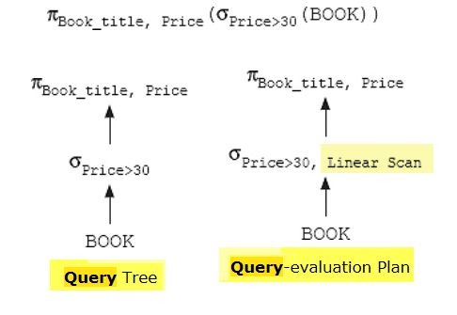
Query Tree vs. Query Plan
Notes:
Each operation in the query (such as select, project, join, etc.) can be evaluated using one of the several different algorithms. The query tree representation does not specify how to evaluate each operation in the query. To fully specify how to evaluate a query, each operation in the query tree is annotated with the instructions that specify the algorithm or the index to be used to evaluate that operation. The resultant tree structure is known as the query-evaluation plan or query-execution plan or simply Query Plan.

Slide 32
Example 2 - SQL To Algebraic Expression Tree
π_{ownerAcc, amount}
SELECT ownerAcc, amount
FROM Transaction
WHERE ownerAcc IN(
SELECT accID
FROM Account
WHERE balance = 1000000)
Transaction
π_{accID}
σ_{balance = 1000000}
Account

Slide 33
Select-Project-Join-Queries
We will focus on Select-Project-Join-Queries (SPJ)
Select <attribute list>
From <relation list>
Where <condition list>
Example Join Query over R(A,B,C) and S(C,D,E):
Select B, D
From R, S
Where R.A = “c” ∧ S.E = 2 ∧ R.C = S.C
How do we execute this query?

Slide 34
- Do Cartesian product
- Select tuples
- Do projection
Plan I
Relational Algebra can be used to describe plans
Π_{B,D} [ σ_{R.A=“c”∧ S.E=2 ∧ R.C = S.C} (RXS)]
Π_{B,D}
σ_{R.A=“c”∧ S.E=2 ∧ R.C=S.C}
X
R S

Slide 35
R X S R.A R.B R.C S.C S.D S.E
a 1 10 10 x 2
a 1 10 20 y 2
.
.
c 2 10 10 x 2
.
.
Select B,D
From R,S
Where R.A = “c” ∧ S.E = 2 ∧ R.C=S.C
Bingo!
Got one...
Answer B D
2 x

Slide 36
Plan II
- Select tuples
- Do natural join
- Do projection
Π_{B,D}
σ_{R.A = “c”} σ_{S.E = 2}
R(A,B,C) S(C,D,E)
Select B,D
From R,S
Where R.A = “c” ∧ S.E = 2 ∧ R.C=S.C

Slide 37
R S
A B C σ (R) σ(S) C D E
a 1 10 A B C C D E 10 x 2
b 1 20 c 2 10 10 x 2 20 y 2
c 2 10 20 y 2 30 z 2
d 2 35 30 z 2 40 x 1
e 3 45 50 y 3
Answer B D
2 x
Select B,D
From R,S
Where R.A = “c” ∧ S.E = 2 ∧ R.C=S.C

Slide 38
Plan III
Use R.A and S.C Indexes
(1) Use R.A index to select R tuples with R.A = “c”
(2) For each R.C value found, use S.C index to find matching tuples
(3) Eliminate S tuples S.E ≠ 2
(4) Join matching R,S tuples, project
B,D attributes, and place in result
Notes:
This is called Index Nested Loop Join strategy

Slide 39
R S
A B C C D E
a 1 10 10 x 2
b 1 20 20 y 2
c 2 10 30 z 2
d 2 35 40 x 1
e 3 45 50 y 3
c 7 15
=“c”
A
C
I1
I2
<c,2,10>
<10,x,2>
check=2?
output: <2,x>
next tuple:
<c,7,15>
Select B,D
From R,S
Where R.A = “c” ∧ S.E = 2 ∧ R.C=S.C

Slide 40
Query Rewrite Rules

Slide 41
Some Query Rewrite Rules
Transform one logical plan into a more efficient one using equivalences in relational algebra
Some common Query Rewrite Rules
Perform Selection operations as early as possible
Cut down the number of rows involved since rows can be discarded sooner
Perform Projection as early as possible.
Cut down the number of columns involved
Combine Selections and Cartesian products into equijoins
Compute common expressions once.
If common expression appears more than once then compute once and store the result and reuse it when required.
Some Subqueries can be converted to Joins
Notes:
Reduces size of intermediate relation since rows can be discarded sooner
Reduces size of intermediate relation since rows of R are discarded sooner
and result not too large,
=> push selections down
Avoid cross-products if possible
Useful when querying views, as same expression is used to construct view each time.
Once an expression tree has been created the plan can be rewritten
Using the algebraic laws discussed previously
Compute common expressions once.
If common expression appears more than once, and result not too large, store result and reuse it when required.
Useful when querying views, as same expression is used to construct view each time.
Combine Cartesian product with the appropriate Selection to form a Natural Join operation.
Use associativity of binary operations to rearrange leaf nodes so leaf nodes with the most restrictive Selection operations are executed first
Cut down the number of rows involved.
This Push projections down the expression tree
May greatly reduce the size of intermediate relations
Push selections down the expression tree as far as possible
Duplicate eliminations may be moved
Selections are pushed down Selections with AND clauses can be split and the components pushed down the tree
Projections should also be pushed down
Selections can be combined with Cartesian products to create equijoins
And additional projections may be added
Do not use statistics
Some are usually good:
Push Avoid cross-products if possible

Slide 42
Equivalences in Relational Algebra
R S = S R Commutativity
(R S) T = R (S T) Associativity
Joins are commutative and associative => Relations may therefore be joined in any order
Also holds for: Cartesian Product, Union, Intersection
R x S = S x R
(R x S) x T = R x (S x T)
R U S = S U R
R U (S U T) = (R U S) U T
Notes:
If an operator is commutative the order of its arguments do not matter
e.g. + (x + y = y + x)
If an operator is associative then two uses of it may be grouped from the left or the right
e.g. (x + y) + z = x + (y + z)
If an operator is associative and commutative then multiple operands can be grouped and ordered in any way

Slide 43
Join Order
The order in which joins and Cartesian products are made affects the size of intermediate relations
Which, in turn, affects the time taken to process a query
Consider these three relations:
Customer = {CustID, fn, ln, age} – 1,000 records
Account = {AcctID, type, balance} – 1,200 records
Owns = {CustID^{fkCustomer}, AcctID^{fkAccount}} – 1,400 records
Owns (Customer Account)
Intermediate relation – 1,000 * 1,200 = 1,200,000 records
(Owns Customer) Account
Intermediate relation – 1,400 records
Notes:
Intermediate relations may vary widely in size depending on the order in which relations are joined

Slide 44
Rules: σ + combined
Let p = predicate with only R attributes
q = predicate with only S attributes
m = predicate with both R,S attributes
σ_{p} (R S) =
σ_{q} (R S) =
[σ_{p} (R)] S
R [σ_{q} (S)]
A selection can be pushed through a Join
Notes:
Selection involves attributes of only one relation

Slide 45
Rules: σ + combined (continued)
σp∧q (R S) = [σp (R)] [σq (S)]
σp∧q∧m (R S) =
σm [(σp R) (σq S)]
σpvq (R S) =
[(σp R) S] U [R (σq S)]
σ_{age>50 ∧ opName="lobotomy"}(Patient Operation) ≡
σ_{age>50}(Patient) σ_{opName="lobotomy"}(Operation))
Example

Slide 46
Example 1 - Initial Logical Plan
π_{B,D}
Select B,D
From R,S
Where R.A = “c” ∧ R.C=S.C
σ_{R.A = “c” Λ R.C = S.C}
X
R
S
Relational Algebra: Π_{B,D} [ σ_{R.A=“c”∧ R.C = S.C} (RXS)]

Slide 47
Apply Rewrite Rule (1) – Break complex selection into simpler ones
π_{B,D}
π_{B,D}
σ_{R.C = S.C}
σ_{R.A = “c” Λ R.C = S.C}
σ_{R.A = “c”}
X
X
R
S
R
S
Π_{B,D} [ σ_{R.C=S.C} [σ_{R.A=“c”}(R X S)]]

Slide 48
Apply Rewrite Rule (2) – Push Selection down
π_{B,D}
π_{B,D}
σ_{R.C = S.C}
σ_{R.C = S.C}
σ_{R.A = “c”}
X
σ_{R.A = “c”}
X
S
R
S
R
Π_{B,D} [ σ_{R.C=S.C} [σ_{R.A=“c”}(R)] X S]

Slide 49
Apply Rewrite Rule (3) – Push Selection Down to replace Cross-Join with Natural Join
π_{B,D}
π_{B,D}
σ_{R.C = S.C}
Natural join
σ_{R.A = “c”}
X
S
σ_{R.A = “c”}
S
R
R
Π_{B,D} [[σ_{R.A=“c”}(R)] S]
Notes:
Avoid Cross-Joins as much as possible

Slide 50
Example 2 - Pushing Selections down
σage>50 ∧ P.patientID=O.patientID ∧ opName = "lobotomy"(Patient × Operation)
σage>50 ∧ P.patientID=O.patientID ∧ opName="lobotomy"
×
Patient
Operation
Pushing selections as far down as possible
result
σ_{age>50}
σ_{opName = “lobotomy"}
Patient
Operation

Slide 51
Do projects early
Example: R(A,B,C,D,E) p condition: (A=3) ∧ (B=“cat”)
πE [σp (R) ] ≡ πE [σp[πABE(R)]]
Projections can be pushed through joins
π_{patientID,age, opName}[σ_{age>50}(Patient) Operation] ≡
σ_{age>50}[π_{patientID,age}(Patient)] π_{patientID,opName}(Operation)

Slide 52
Example 3 – Initial relational algebra tree
SELECT * FROM Staff s, Branch b
WHERE s.branchNo = b.branchNo
AND s.position = ‘Manager’ AND b.city=‘London’ ;
σ b.city=‘London’
σ s.position = ‘Manager’
σ s.branchNo = b.branchNo
X
Staff
Branch

Slide 53
Example 3 – Improved relational algebra tree
The selections have been done first to reduce the number of rows involved in the join
σ s.position = ‘Manager’
σ b.city=‘London’
Staff
Branch
Notes:
The join and related WHERE condition have been recognised as a natural join

Slide 54
Summary of Optimization Rules
Perform selection early (reduces number of tuples)
Perform projection early (reduces number of attributes)
Replace Cartesian Product by join whenever possible
Pick a good join order, based on the expected size of intermediate results

Slide 55
Physical Query Plan

Slide 56
Generate Physical Plan
SQL query
parse
parse tree
Enumerate possible
physical plans
Query rewriting
statistics
Best logical query plan
Physical plan generation
Find the cost of
each plan
Best physical query plan
Pick plan with
minimum cost
execute
result
Notes:
Rules that will improve performance with very high probability
Preprocessing: Getting queries into a form that DBMS knows how to handle best
Choose algorithm to implement each operator
Need to account for more than cost:
How much memory do we have ?
Are the input operand(s) sorted ?
Decide for each intermediate result:
To materialize
To pipeline
No magic “best” plan: depends on the data
In order to make the right choice
need to have statistics over the data
the B’s, the T’s, the V’s

Slide 57
Approaches to Query Evaluation
Many DB operations require reading tuples, comparing attributes of tuples with values, or comparing tuples from different tables
Techniques generally used:
Iteration: for/while loop to scan and compare tuples of a Relation
Index lookup: if comparison of attribute that’s indexed, look up matches in index & return those
Sort/merge: iteration against presorted data
Hash: build hash table of the tuple list, probe the hash table
Must be able to support larger-than-memory data
Notes:
Approaches to Evaluation
• Algorithms for evaluating relational operators use some simple ideas extensively:
– Indexing: Can use WHERE conditions to retrieve small set of tuples (selections, joins)
– Iteration: Sometimes, faster to scan all tuples even if there is an index. (And sometimes, we can scan the data entries in an index instead of the table itself.)
– Partitioning: By using sorting or hashing, we can partition the input tuples and replace an expensive operation by similar operations on smaller inputs.

Slide 58
Logical Plans Vs. Physical Plans
π_{B,D}
Project
Hash join
σ_{R.A = “c”}
S
Index scan
Table scan
R
R
S
Best logical plan
Physical Plan = Select algorithms for each of the operators in the query + Decide Pipelining vs. Materialization of intermediate results

Slide 59
Physical Plan Generation
Logical Query Plan
P1 P2 …. Pn
C1 C2 …. Cn
Pick minimum cost one
Physical
plans
Costs

Slide 60
Operator Plumbing: Materialization vs. pipelining
π_{B,D}
Plumbing needed here
σ_{R.A = “c”}
S
R
Materialization:
output of one operator written to disk, next operator reads from the disk
Pipelining:
output of one operator directly fed to next operator
Saves on cost of creating temporary relations and reading results back in again
Notes:
Materialization
The output of one operation is stored in a temporary relation for processing by next.
Pipelining or on-the-fly processing
Pipeline results of one operation to another without creating temporary relation.
Saves on cost of creating temporary relations and reading results back in again.
Generally, a pipeline is implemented as separate process or thread.

Slide 61
Pipelining Example
join and select/project act as co-routines, operate as producer/consumer sharing a buffer in main memory.
When join fills buffer; select/project filters it and outputs result
Process is repeated until select/project has processed last output from join
Performing select/project adds no additional cost
join
Intermediate
result
select/project
output
final result
buffer

Slide 62
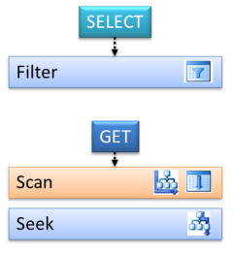
Implementing Selection σ_{(attr op value)}

Slide 63
Computing Selection σ_{(attr op value)}
The algorithm to use for implementing Selection depend on the indexes and data file organization
Key strategies:
File scan: can be used for any condition
B⁺ tree seek: equality or range search
Hash index seek: equality search
Notes:
Binary search: relation sorted on a sequence of the search attribute
; all search key attributes of hash index are specified in condition
Binary search: relation sorted on a sequence of the search attribute
Access path is the notion that denotes algorithm + data structure used to locate rows satisfying some condition
; a prefix of the search key attributes are specified in condition
B⁺ tree supports a variety of access paths
Example: Given a B⁺ tree whose search key is the sequence of attributes a2, a1, a3, a4
Access path for search σ_{a1>5 AND a2=3 AND a3=‘x’} (R): find first entry having a2=3 AND a1>5 AND a3=‘x’ and scan leaves from there until entry having a2>3 or a3 ≠ ‘x’. Select satisfying entries
Access path for search σ _{a2=3 AND a3 >‘x’} (R): locate first entry having a2=3 and scan leaves until entry having a2>3. Select satisfying entries
Access path for search σ _{a1>5 AND a3 =‘x’} (R): Scan of R
Selectivity of an access path = number of blocks retrieved using that path
If several access paths support a query, DBMS chooses the one with lowest selectivity
Size of domain of attribute is an indicator of the selectivity of search conditions that involve that attribute
Example: σ _{CrsCode=‘CS305’ AND Grade=‘B’} (Transcript)
a B⁺ tree with search key CrsCode has lower selectivity than a B⁺ tree with search key Grade

Slide 64
σ_{(attr op value)} with No index on attr
If rows are not sorted on attr:
Scan all data blocks to find rows satisfying selection condition
Cost = B(R) (# of blocks for relation R)
Avg Cost = B(R) / 2 - if attr is a key (the scan is terminated when the required record is found)
Notes:
– B(R) = # of blocks for relation R
– T(R) = # of tuples in relation R
If rows are sorted on attr and op is =, >, < then:
Use binary search to locate first data block containing row in which (attr = value)
Scan further to get all rows satisfying (attr op value)
Cost = log₂ B(R) + (cost of scan of additional blocks)

Slide 65
σ_{(attr op value)} with Clustered B+ tree index on attr
Clustered B⁺ tree index on attr (for “=” or range search):
Locate first index entry corresponding to a row in which (attr = value).
Cost = depth of tree
Rows satisfying condition packed in sequence in successive data blocks; scan those blocks.
Cost = number of blocks occupied by qualifying rows
B⁺ tree
index entries
(containing rows)
that satisfy
condition

Slide 66
σ_{(attr op value)} with Unclustered B+ tree index on attr
Unclustered B⁺ tree index on attr (for “=” or range search):
Locate first index entry corresponding to a row in which (attr = value).
Cost = depth of tree
Index entries with pointers to rows satisfying condition are packed in sequence in successive index blocks
Scan entries to identify table data blocks with qualifying rows
Any block that has at least one such row must be fetched once
Cost = number of qualifying rows
Notes:
number of rows that satisfy selection condition
Select satisfying entries
and sort record Ids

Slide 67
Unclustered B⁺ Tree Index
index entries (containing
row Ids) that satisfy
condition
data page
Data file
B⁺ Tree

Slide 68
Unclustered B+ Tree Range Selection
SELECT *
FROM Patient
WHERE lName = 'Marid'
σ_{lName = "Marid"}(Patient)
…
…
…
…
4 patients called Marid
file

Slide 69
σ_{(attr = value)} with Hash index on attr
Hash index on attr (for “=” search only):
Cost ≈ 1.2
1.2 – typical average cost of finding an entry in a hash index (> 1 due to possible overflow chains)
Finds the bucket containing all index entries satisfying selection condition
Clustered index – all qualifying rows packed in sequence in successive data blocks; scan those blocks
Cost = number of blocks occupied by qualifying rows
Unclustered index – scan the index entries to identify data blocks with qualifying rows
Each page containing at least one such row must be fetched once
Cost = number of qualifying rows in bucket
Notes:
Select satisfying entries
, number of blocks in file
(a few blocks)

Slide 70
Unclustered Hash Index
Unclustered hash index on attr (for equality search)
buckets
data blocks
Notes:
Recall basics:
There are n buckets
A hash function h(k) maps a key k to {0, 1, …, n-1}
Store in bucket h(k) a pointer to record with key k
Secondary storage: bucket = block, use overflow blocks when needed

Slide 71
Sort-Merge Algorithm

Slide 72
External Sorting
Sorting is used in implementing many relational operations such Select Distinct
Problem:
Relations are typically large, do not fit in main memory (e.g., sort 1Gb of data with 1Mb of RAM)
So cannot use traditional in-memory sorting algorithms
=> Combine in-memory sorting with clever techniques aimed at minimizing I/O
External sorting has two main components:
I/O necessary to move records between disk and main memory
Computation involved in sorting records in buffers in main memory
Notes:
External sort-merge algorithm.
If a relation entirely fits in the main memory, in-memory sorting (called internal sorting) can be performed using any standard sorting techniques such as Quick Sort. If the relation does not fit entirely in the main memory, external sorting is required. In external sorting, some part of the relation is read in the main memory, sorted and written back to the disk. This process continues until the entire relation is sorted. The most commonly used external sorting algorithm is the external sort-merge algorithm. The external sort-merge algorithm is divided into two phases, namely sort phase and merge phase.
Sort phase: In this phase, the records in the file to be sorted are divided into several groups, called runs such that each run can fit in the available buffer space. An internal sort is applied to each run and the resulting sorted runs are written back to the disk as temporarily sorted runs. The number of initial runs (n_{i}) is computed as b_{R}/M, where b_{R} is the number of blocks containing records of relation R and M is the size of available buffer in blocks.
Merge phase: In this phase, the sorted runs created during the sort phase are merged into larger runs of sorted records. The merge continues until all records are in one large run.

Slide 73
Sort-Merge Algorithm Sort phase
M = # memory blocks available
β_{r} = # blocks in file to be sorted
Sort-Merge algorithm has two phases: Sort then Merge
Sort phase: sort M blocks at a time; create B/M sorted runs on Disk as temporary sub-files. Cost = 2β_{r}
The number of initial runs n_{R} = ⎡ β_{r} / M ⎤
Original file
5 3
2 6
1 10
15 7
20 11
8 4
7 5
Partially sorted file
1 2
3 5
6 10
4 7
8 11
15 20
5 7
run
Example: M = 3, B = 7
Notes:
Sort phase: In this phase, the records in the file to be sorted are divided into several groups, called runs
such that each run can fit in the available buffer space. An internal sort is applied to each run and the
resulting sorted runs are written back to the disk as temporarily sorted runs. The number of initial runs (ni)
is computed as bR/M , where bR is the number of blocks containing records of relation R and M is the size of
available buffer in blocks.
Merge phase: In this phase, the sorted runs created during the sort phase are merged into larger runs of
sorted records. The merge continues until all records are in one large run. The output of merge phase is the
sorted relation.

Slide 74
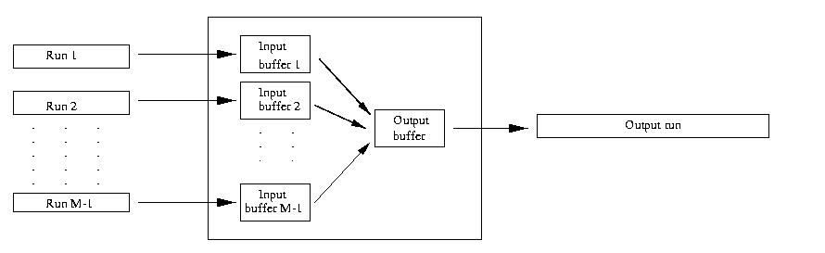
Sort-Merge Algorithm Merge Phase
Merge Phase: merge all runs into a single run using M-1 buffers for input and 1 Output Buffer
Divide runs into groups of size M-1 and merge each group into a larger run of sorted records
Number of Passes for merge phase = ⎡Log_{M-1}n_{R}⎤
Cost of Merge Phase = 2 β_{r} * Number of Passes
Total Cost = 2 β_{r} * (# of passes for Merge Phase + 1)
Buffer
M blocks
Notes:
Total Cost = 2B * (# of passes for Merge Phase + 1) // 1 pass is required for the sort phase
each step reduces number of runs by a factor of M-1
Define degree of merging
In an external sort-merge algorithm, if the number of initial runs (n_{i}) is greater than the size of the available buffer space in blocks (M), then it is not possible to perform the merge operation in one pass; rather multiple passes are required. In each pass, M-1 buffer blocks are used to hold one block from each of the M-1 input runs, and one buffer block is kept for holding one block of the merge result. The number of runs that can be merged together in each pass is known as degree of merging (d_{M}). Thus, the value of d_{M} is the smaller of (M-1) or n_{i}. If two runs are merged in each pass, it is known as two-way merging. In general, if N runs are merged in each pass, it is known as N-way merging. The number of passes required can be calculate as (log_{dM} (n_{R}) .
Example shows two-way merging where we have assumed that the main memory holds at most three page frames out of which two are used as input and one for output during the merge phase. In this figure, d_{M} = 2, and n_{R} = 4; therefore, (log₂ (4) = 2 passes are required. In simple terms, with d_{M} = 2, 4 initial sorted runs would be merged into 2 at the end of first pass, which are then merged into 1 sorted run at the end of the second pass.
Another approach but I do not like it!
Cost of merge phase:
(B/M)/(M-1)^{k} runs after k merge steps
⎡Log _{M-1}(B/M)⎤ merge steps needed to merge an initial set of B/M sorted runs
cost = ⎡ 2B Log _{M-1}(B/M) ⎤ ≈ 2B(Log _{M-1}B -1)
Total cost = cost of partial sort phase + cost of merge phase ≈ 2B Log _{M-1}B

Slide 75
Merge Example
Input runs
Output run
2 3
5 6
2
5
3
6
10
3
6
1
2
5
7
15
1 2
3 5
6 7
10 15
1 7
10 15
10
1
7
15
Input buffers
Output buffer
Notes:
In each pass, M-1 buffer blocks are used to hold one block from each of the M-1 input runs

Slide 76
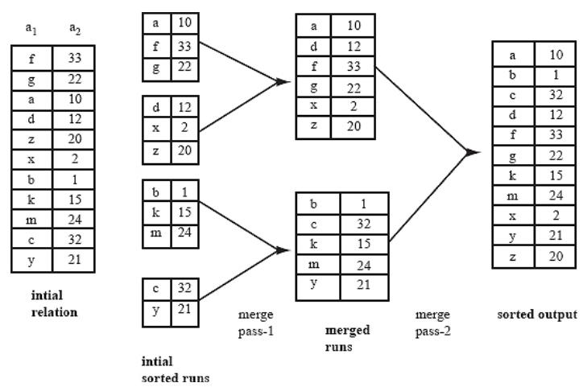
Sort-Merge Example
Notes:
Cut this and do animation + print it and explain on the board.
M = 3
B = 11
nR = [11/3] = 4
# Passes = [Log(M-1)(nR)] = Log2(4) = 2

Slide 77
Example Sort Merge Cost
Buffer : with 5 buffer blocks
File to sort : 108 blocks
The number of initial runs?
How many merge passes?
Pass 0 (Sort Phase):
Size of each run?
Number of runs?
Pass 1:
Size of each run?
Number of runs?
Pass 2: ???
Notes:
8
nR = 108/5 =
Log(m-1)(nR)
5

Slide 78
Example Sort Merge Cost
Buffer : with 5 buffer blocks
File to sort : 108 blocks
The number of initial runs? 22
How many merge passes? ⎡Log_{M-1}n_{R}⎤ = ⎡Log₄22⎤ = 3
Pass 0: = 22 sorted runs of 5 blocks each (last run is only 3 blocks)
Pass 1: = 6 sorted runs of 20 block each (last run is only 8 blocks)
Pass 2: 2 sorted runs, 80 blocks and 28 blocks
Pass 3: Sorted file of 108 blocks
Sort
Merge
Total I/O costs? = 2B * (4 passes)
Notes:
8

Slide 79
Duplicate Elimination
A major step in computing Distinct Projection, Union, and Difference relational operators
Algorithm:
Sort
During the merge step eliminate duplicates on the fly
No additional cost (with respect to sorting) in terms of I/O

Slide 80
Duplicate elimination During Merge
Input runs
Last key used
Output run
2 3
5 6
5
2
3
6
1
2
15
3
5
6
3
6
1
2
5
15
1 2
3 5
6 15
1 3
5 15
1
5
3
15
Key 3 ignored: duplicate
Key 5 ignored: duplicate
Input buffers
Output buffer

Slide 81
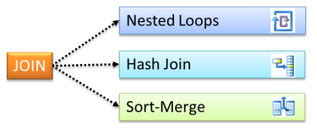
Join Operator Implementation
Notes:
Look
http://netindonesia.net/blogs/kasim.wirama/archive/2008/05/18/nested-loop-merge-join-and-hash-join-algorithm.aspx
http://sqlblog.com/blogs/paul_white/archive/2012/04/28/query-optimizer-deep-dive-part-2.aspx
If you observe execution plan on your query using join types, you will find out the following operators: nested loop, merge loop and hash join. I would like to describe algorithm for each of them.
Nested loop
As its name implies, it will iterate each rows at outer input set to query rows at inner input set. The cost will be multiplication between inner input and outer input rows. The algorithm for nested loop is shown below :
For each R1 in outer input set For each R2 in inner input set If R1 match with R2 Output (R1, R2)
R1 and R2 are rows for outer and inner input sets.
Merge Join
Merge join will output rows from both input sets that have their matches by comparing 2 inputs sets that have been already sorted. Cost of merge loop is sum of number of both inputs. Algorithm for merge join is shown below :
Read first R1 at first input set Read first R2 at second input set While not reach the end of either of the inputs begin if R1 match R2 begin output (R1, R2) get next R2 end else if R1 less than R2 get next R1 else get next R2 end
Hash join
Hash join will output qualified resultset by comparing hash value of second input set to hash value of first input set. It will create hash table (called build table) for first input set, then compare hash value of second input set to the build table. It is undesirable operator in most OLTP scenarios. The algorithm for hash join is shown below :
Create build table For each R1 begin generate hash value of R1 join key insert into build table to appropriate hash bucket end for each R2 begin generate hash value of R2 join key for each R1 in corresponding hash bucket if match R1 and R2 output (R1,R2) end
Queries that require joins or Cartesian products can be expensive
Regardless of the process the result’s size can be estimated (using available statistics)
However, intermediate relations may vary widely in size depending on the order in which relations are joined

Slide 82
Join Operation Implementation
SELECT * FROM Reservations R, Sailors S where R.sid = S.id
The main strategies for implementing the join are:
Block Nested Loop Join
Indexed Nested Loop Join
Sort-Merge Join
Hash-Join (building a Hash index on the fly)
Notes:
Product(pname, cname) ⋈ Company(cname, city)
Basic algorithm
Scan-based (e.g., NLJ)
Sort-based
Using existing indexes
Hash-based (building an index on the fly)

Slide 83
Operator Cost Model
We will compare the Join implementation strategies using a simple cost model
Count # of disk blocks read and written during operator execution
Cost of query plan = Sum of operator costs
Ignoring CPU costs
Parameters used in Cost Model
β_{r} = # blocks storing R tuples
T_{r} = # tuples in R
M = # memory blocks available
Notes:
V(R,A) = # distinct values of attr A in R
Extends to query plans
Caution:
τ

Slide 84
Nested Loop Join (NLJ)
R
S
B | C
a | 10
a | 20
b | 10
d | 30
C | D
10 | cat
40 | dog
15 | bat
20 | rat
R
S
NLJ can be:
Tuple-based
Block-based
NLJ (conceptually)
for each r ∈ R do
for each s ∈ S do
if (r.C = s.C) then output r,s pair
Notes:
You can see that the first set is fully scanned. This is the Outer or Driving Set. For every record in this set, we look up a matching record in the second set. Usually this will be done through an index, even though this is not mandatory.
The simplest join algorithm is nested loop that joins two relations together a tuple at a time.
For each tuple in the outer relation R
Scan the entire inner relation S
if match found, add to result
As the basic unit of reading/writing is a disk block, a better approach would be
For each block of R
For each block of S
Check each row of R with each row of S as above

Slide 85
Nested Loop Join (NLJ) Example
select * from Customer c, Rental r where c.accountId = r.accountId
Simple nested loops join
while (not customer.eof()) {
c = customer.read();
rental.reset();
while (not rental.eof()) {
r = rental.read();
if (c.accountId==r.accountId) {
result.write(c, r);
}
}
Can reduce cost by comparing all records in block of customer against all rentals
Notes:
Cost is B_{c} + R_{c} × B_{r}

Slide 86
Analysis of Tuple-based NLJ
Cost with R as outer = T_{r} + (T_{r} x T_{s})
Cost with S as outer = T_{s} + (T_{s} x T_{r})
Notes:
M >= 2

Slide 87
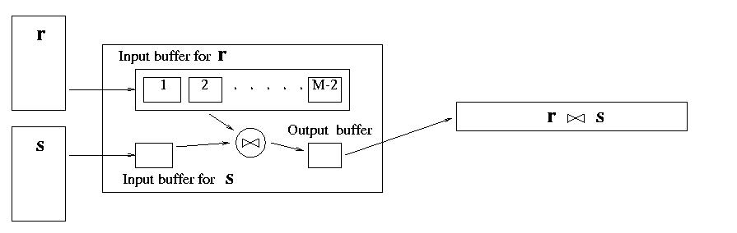
Block-based NLJ
Suppose R is outer
Loop { Get the next (M-2) R blocks into memory
Join these with each block of S }
Cost: β_{r} + (β_{r} /M-2) x β_{s}
What if S is outer?
β_{s} + (β_{s} /M-2) x β_{r}
Number of scans of relation S

Slide 88
Block-Nested Loop Illustrated
Input buffer for R
R
R S
S
… and so on
Input buffer for S
Output buffer

Slide 89
Index-Nested Loop Join r _{A=B} s
Use an index on S with search key B (instead of scanning S) to find rows of S that match t_{r}
Cost = β_{r} + (T_{r} ∗ ω)
Effective if number of rows of S that match tuples in R is small (i.e., ω is small) and index is clustered
avg cost of retrieving all rows in S that match t_{r}
Number of rows in r
foreach tuple t_{r} in R do {
use index to find all tuples t_{s} in s satisfying t_{r}.A=t_{s}.B;
output (t_{r}, t_{s})
}
Notes:
+ cost of outputting final result
τ

Slide 90
Indexed Nested Loop Join
B | C
a | 10
a | 20
b | 10
d | 30
Index I on S.C
C | D
10 | cat
40 | dog
15 | bat
20 | rat
R
S
Indexed NLJ (conceptually)
for each r ∈ R do
scan index for matching tuples of S
for each s ∈ matching tuples of S do
output r,s pair
Notes:
If there is an index on the join attributes of the inner relation, we can use index lookup.
For each tuple in R
Scan index for matching tuples of S
Use index to access the tuple in S
Assume R1.C index exists; 2 levels
Assume R2 clustered, unordered
Assume R1.C index fits in memory

Slide 91
Indexed Nested Loop Join Example
while (not customer.eof()) {
Customer c= customer.read();
Rental r[] = rental.readByAcctId(c.accountId);
for (int i=0; i<r.length; i++) { result.write(c,r[i]);
}
}
Notes:
Cost is B_{c} + R_{r} instead of B_{c} + R_{c} × B_{r} without index
Reduce cost by processing a block at a time?

Slide 92
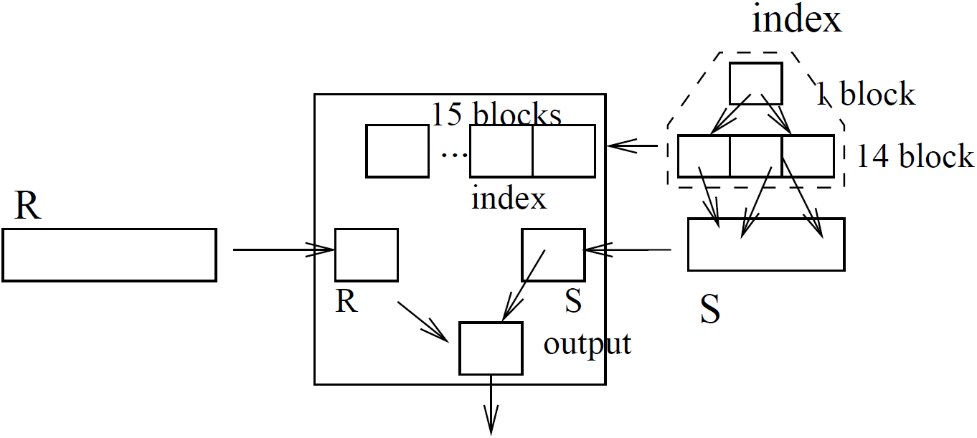
Indexed Nested Loop Join

Slide 93

Sort-Merge Join R S
Best when the R & S are both ordered on their join columns
R & S are read in an alternating way:
You start reading the R, then you read S until you find a matching value or exceed the value
Append matching tuples to the result
If you pass the join value, you continue reading R again
# of disk IOs during merge:
Notes:
Sort R and S on the join column
Then scan them to do a ``merge’’ on the join column:
Advance scan of R until current R-tuple >= current S tuple, then advance scan of S until current S-tuple >= current R tuple; do this until current R tuple = current S tuple
Add any matching records <r, s> to the result set
Then resume scanning R and S
A Merge Join is possible when 2 datasets are both ordered on their join columns. The datasets can then be read in an alternating way. You start reading the first dataset, then you read the second dataset until you find a matching value, or exceed the value. If it is a matching value, you can start building your result set. If you pass the join value, you continue reading the first dataset again.
Merge join will output rows from both input sets that have their matches by comparing 2 inputs sets that have been already sorted. Cost of merge loop is sum of number of both inputs. Algorithm for merge join is shown below :
Read first R1 at first input set Read first R2 at second input set While not reach the end of either of the inputs begin if R1 match R2 begin output (R1, R2) get next R2 end else if R1 less than R2 get next R1 else get next R2 end
A Merge Join is possible when 2 datasets are both ordered on their join columns. The datasets can then be read in an alternating way. You start reading the first dataset, then you read the second dataset until you find a matching value, or exceed the value. If it is a matching value, you can start building your result set. If you pass the join value, you continue reading the first dataset again.
Sort R on join attribute i
Sort S on join attribute j
Scan files concurrently, matching records with same join attribute
The most efficient join is when both relations are sorted on the join attributes, then ‘merge’ by scanning through both looking for matching values

Slide 94
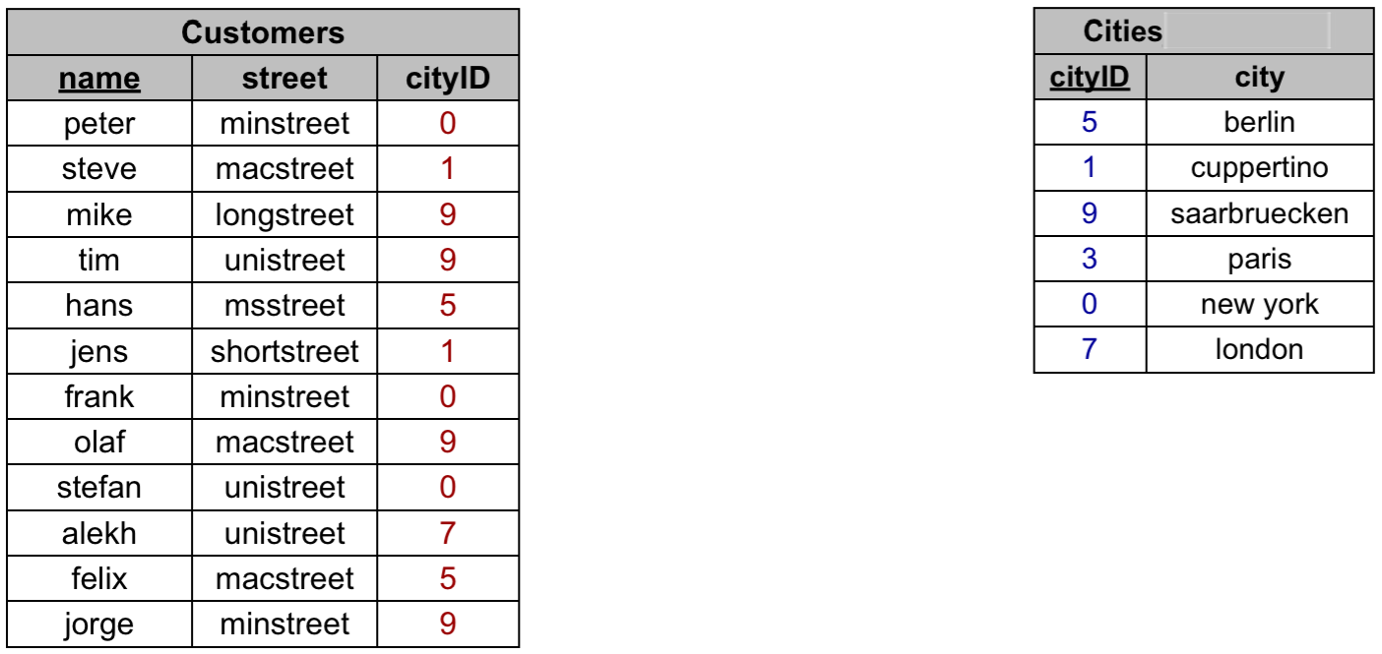
Sort-Merge Example

Slide 95
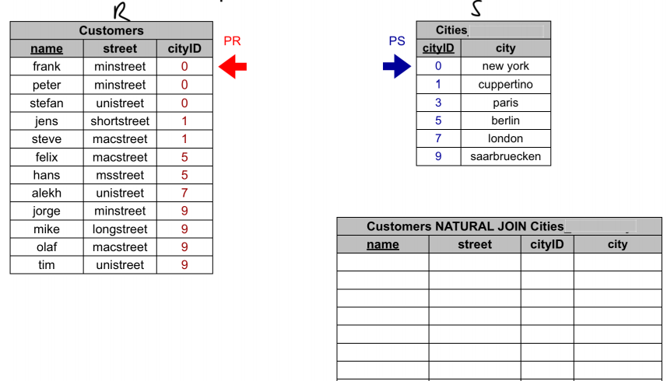
Sort-Merge Example

Slide 96
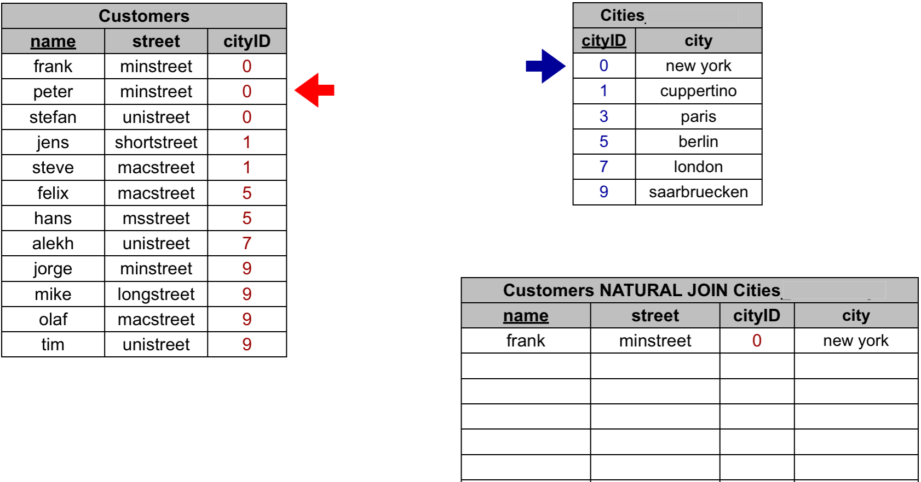
Sort-Merge Example
Values pointed to are equal => Found join result
Move left pointer…

Slide 97
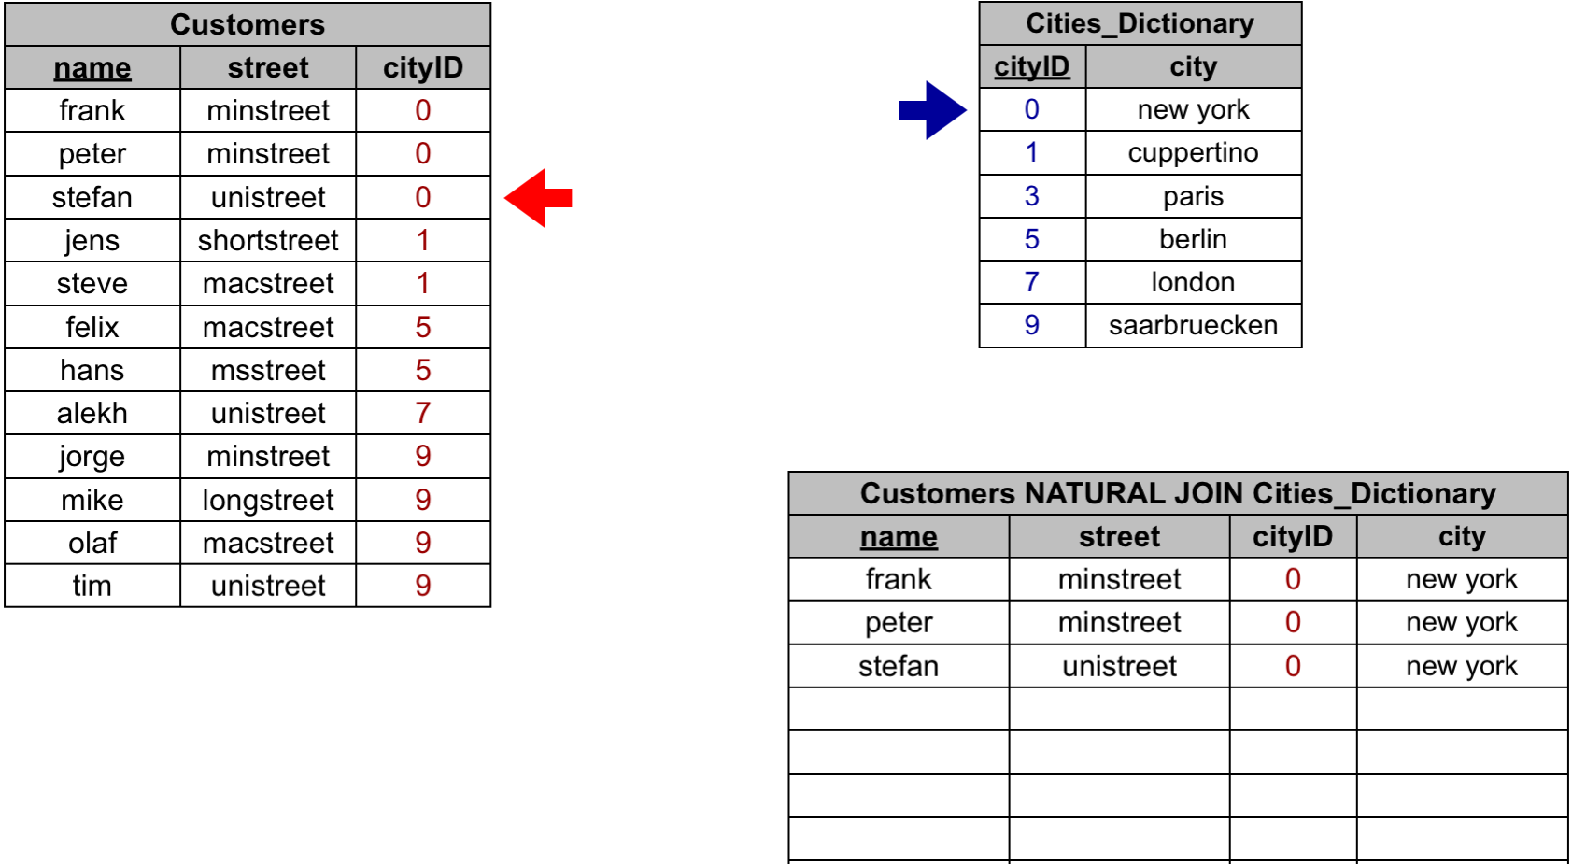
Sort-Merge Example
Values pointed to are equal => Found join result
Continue moving the left pointer…

Slide 98
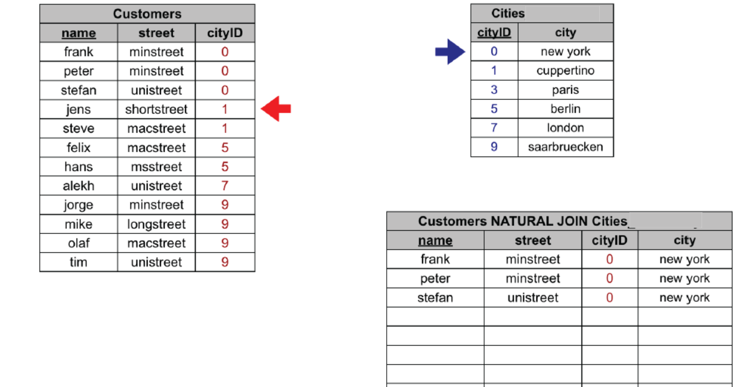
Sort-Merge Example
Values pointed to are NOT equal => Move the pointer pointing to the smaller value

Slide 99
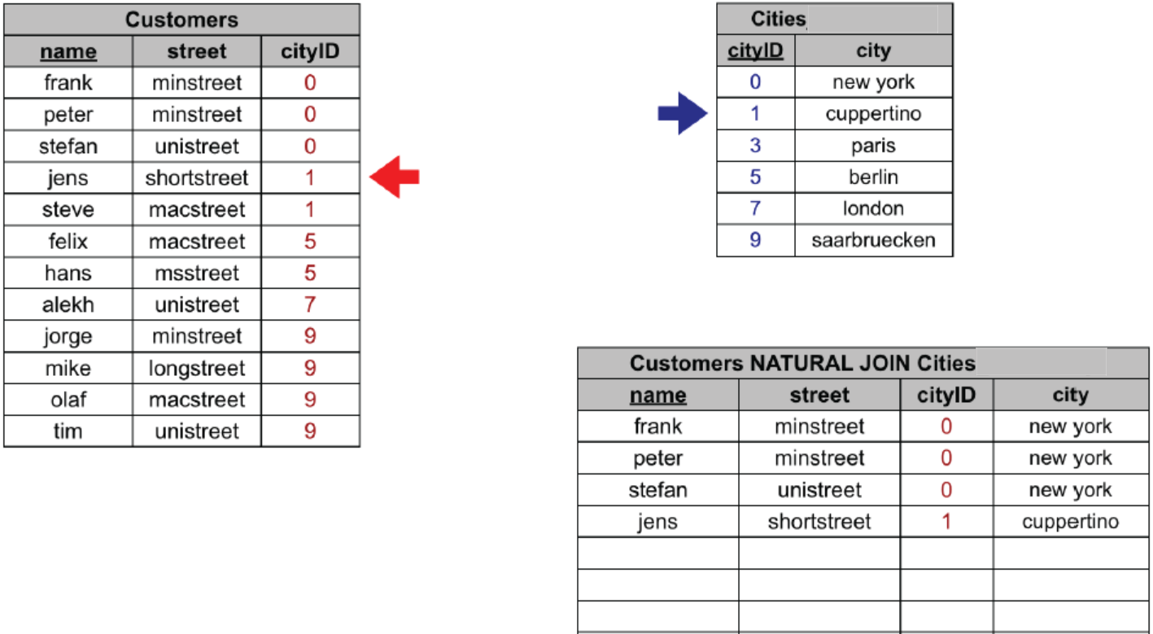
Sort-Merge Example
Values pointed to are equal => Found join result
Continue moving the left pointer…

Slide 100
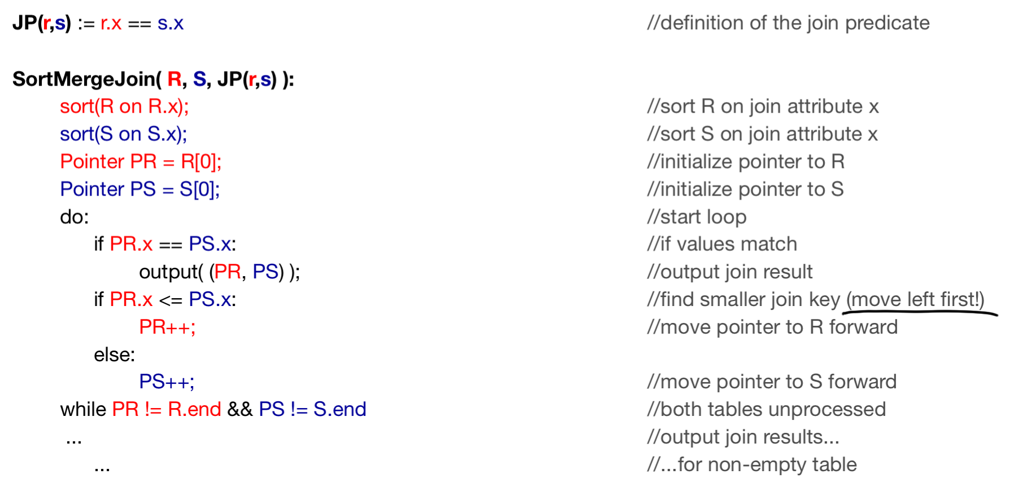
Algorithm

Slide 101
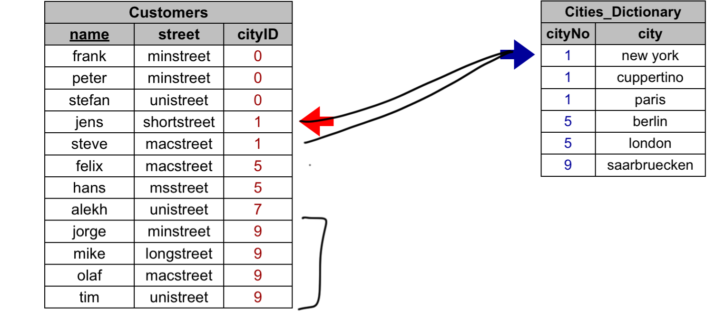
Duplicates in both Columns =>
=> Use Co-Grouping then Cross-Join co-groups

Slide 102
Co-Grouping then Cross-Join co-groups illustrated
R
D
A
1 3
p p
0 9
q q
8 7 3
s s s
5 7
u u
1 1
v v
1 1 3 3
p p p p
p p p p
4 0 4 0
8 7 3
s s s
s s s
7 7 7
5 5 5 7 7 7
u u u u u u
u u u u u u
2 5 0 2 5 0
A
E
p p
4 0
r
9
s
7
t t
2 5
u u u
2 5 0
x
0
R S
S
Notes:
A Merge Join is possible when 2 datasets are both ordered on their join columns. The datasets can then be read in an alternating way. You start reading the first dataset, then you read the second dataset until you find a matching value, or exceed the value. If it is a matching value, you can start building your result set. If you pass the join value, you continue reading the first dataset again.
Merge join will output rows from both input sets that have their matches by comparing 2 inputs sets that have been already sorted. Cost of merge loop is sum of number of both inputs. Algorithm for merge join is shown below :
Read first R1 at first input set Read first R2 at second input set While not reach the end of either of the inputs begin if R1 match R2 begin output (R1, R2) get next R2 end else if R1 less than R2 get next R1 else get next R2 end

Slide 103
Total Cost for Sort-Merge Join
Sort Cost
Merge Cost

Slide 104

Hash-Join R _{A=B} S
Hash function h(v), range 1 → k
Hashing stage (bucketizing): hash tuples into buckets
Hash R tuples into buckets R₁, R₂, ... R_{k}
Hash S tuples into buckets S₁, S₂, ... S_{k}
Join stage: join tuples in matching buckets
For i = 1 to k do
Match tuples in R_{i}, S_{i} buckets
Cost =
Notes:
“Hashes” the join column/s from one side of join
“Probes” with the other side (the larger)
Basic operation
Q: SELECT … FROM R, S WHERE R.key = S.key
Build the hash table with keys of the inner relation (S)
Iterate the outer tuples (R) and find matching keys in the hash table
Append matching tuples to the output
- By partitioning the data, we reduced the problem of joining to smaller sub-relations Ri and Si.
- Matching tuples are guaranteed to end up together in the same partition.
- We only need to compute Ri |><| Si (for all i).

Slide 105
Hashing Stage
R
Buckets
OUTPUT
1
Partition tuples in R and S using join attributes as key hash
Tuples in partition R_{i} only match tuples in partition S_{i}.
R₁
INPUT
2
hash
function
h
R₂
. . .
k
R_{k}
S
Buckets
OUTPUT
1
S₁
INPUT
2
S₂
. . .
hash
function
h
k
S_{k}
Notes:
14
Partitioned Hash-Join

Slide 106
Join stage
Join tuples in matching buckets
For i = 1 to k do
Match tuples in R_{i}, S_{i} buckets
Buckets
for S
Buckets
for R
S₁
R₁
S₂
R₂
Join
S_{i}
R_{i}
R_{k}
S_{k}
Memory
Notes:
14

Slide 107
Comparing Join Algorithms
Nested Loop Join ( brute force)
Efficient if either R or S fits in main memory.
Index Join
Suitable only if one of the table has an index on the join attributes.
Sort-Merge Join
Good for non-equi-join (e.g., R.C > S.C). Good choice when both tables are very large
Less sensitive to data skew, very efficient given a sorted index, result is sorted
Hash Join
Usually best for equi-join, where relations not sorted and no indexes exist. Requires less memory, highly parallelizable
Notes:
Sort-Merge Join vs. Hash Join:
Given a minimum amount of memory both have a cost of 3(B(R) + B(S)) I/Os.
Advantages of Hash Join: requires less memory, highly parallelizable.
Advantages of Sort-Merge:.
NESTED LOOP JOIN
when the outer input is small and the inner input has an index on the join key
No restriction on operators; Inputs need not be sorted
MERGE JOIN:
Medium to large inputs
Requires equality operator & inputs must be sorted on join predicate
HASH JOIN:
Large inputs
Requires equality operator
Join techniques apply to Union, Intersection, Difference
If index exists, it could be useful
Depends on expected result size and index clustering
NLJ ok for “small” relations
using an access structure (

Slide 108
Estimating Intermediate Result Sizes
What algorithm to be use for query processing depends very strongly on the sizes of the relations
Notes:
Still an area of research today!

Slide 109
The number of tuples after selection
A good guess, though never true in practice. Does not require storing many statistics.
S = σ_{A=c}(R)
0 <= T(S) <= T(R)
Expected value: T(S) = T(R)/V(R,A)
S = σ_{A<c}(R)
T(S) can be anything from 0 to T(R)
Heuristic: T(S) = T(R)/3
Of course one can do better!

Slide 110
Histograms tell you how many tuples have R.A values within a certain range
Maintained by the RDBMS
Makes size estimation much more accurate (hence, cost estimations are more accurate)
Employee(ssn, name, salary, phone)
Salary: | 0..20k | 20k..40k | 40k..60k | 60k..80k | 80k..100k | > 100k
Tuples | 200 | 800 | 5000 | 12000 | 6500 | 500
Notes:
T(Employee) = 25000, but now we know the distribution

Slide 111
The number of tuples after a join
R ⋈_{A} S
When the set of A values are disjoint, then
T(R ⋈_{A} S) = 0
When A is a key in S and a foreign key in R, then T(R ⋈_{A} S) = T(R)
When A is a key in both R and S, then
T(R ⋈_{A} S) = min(T(R), T(S))
Otherwise…
T(R ⋈_{A} S) = T(R) T(S) / max(V(R,A),V(S,A))

Slide 112
Join Size Estimation
R _{A=B} S
T(R) x T(S)
max(V(R,A) , V(S,B))
Parameters:
T(R) = # tuples in R
T(S) = # tuples in S
V(R, A) = # of distinct values of attribute A in R
V(R, B) = # of distinct values of attribute B in S

Slide 113
Example of estimating the number of tuples after a join
T(R) = 10,000 T(S) = 20,000
V(R,A) = 100 V(S,A) = 200
How large is R ⋈_{A} S ?
Answer: T(R ⋈_{A} S) = 10000 * 20000/200 = 1M

Slide 114
The expected number of tuples after a join on multiple attributes is:
T(R ⋈_{A,B} S) = T(R) * T(S)
[max(V(R,A),V(S,A)) * max(V(R,B),V(S,B))]

Slide 115
Summary
Query optimization (QO) is an important task in a relational DBMS
Understanding QO is necessary to write better queries that optimize well, and to debug plan-related performance problems
QO has 2 parts
Enumeration of alternative plans
Estimation of cost of enumerated plans
+ Select the cheapest plan
Key issues – query trees, operator implementation, use of indexes
Notes:
Queries are composed of a few basic operators; the implementation of these operators can be carefully tuned (and it is important to do this!).
Many alternative implementation techniques for each operator; no universally superior technique for most operators.
Must consider available alternatives for each operation in a query and choose best one based on system statistics, etc.
Understanding of QO is necessary to understand the impact
Of a given database design (relations, indexes)
On the workload given by a set of queries
Pruning of search space : left-deep plans only
Size of results
Cost of each plan node

